Slide 1
Presented By Group members SAIF UR REHMAN L1F20BSSE0393 Abdul basit L1F19BSSE0297 MATEEN ASGHAR L1S20BSSE0061 FAHAD SUBMITTED TO SIR RAO FAIZAN
SAIF UR REHMAN L1F20BSSE0393​
ABDUL BASIT L1SSAIF UR REHMAN L1F20BSSE0393​
e
ABDUL BASIT L1S20BSSE0061​erg4;e
MATEEN ASGHAR L1F19BSSE0061​
FAHAD ​
​20BSSE0061​
MATEEN ASGHAR L1F19BSSE0061​
FAHAD ​
​

Slide 2
Title: Image Classification with Convolutional Neural Networks (CNN) using CIFAR-100 and Keras

Slide 3
Introduction
Welcome, everyone!
Today, we'll delve into the fascinating world of image classification using Convolutional Neural Networks (CNN).
Image classification is a critical task in the field of computer vision, enabling machines to identify and categorize objects within images.
CNNs have proven to be highly effective for this purpose, mimicking the visual processing of the human brain.
In this presentation, we'll explore how CNNs work and apply them to the CIFAR-100 dataset using the popular deep learning library, Keras.

Slide 4
Background
Image Classification Importance:
Crucial for AI Perception: Allows machines to interpret and understand visual data, enabling applications like facial recognition, autonomous vehicles, and medical image analysis.
Enhances Human-Computer Interaction: Enables computers to "see" and respond intelligently to visual information, enhancing user experiences.
Introduction to CNNs:
Inspired by Biological Vision: CNNs are neural networks inspired by the human visual system, designed to automatically and adaptively learn spatial hierarchies of features.
Effective for Image Tasks: CNNs excel in image-related tasks, capturing patterns, textures, and shapes hierarchically.
CIFAR-100 Dataset:
Diverse Image Categories: CIFAR-100 contains 60,000 32x32 color images across 100 classes, offering a rich and diverse set of visual data.
Challenges and Real-World Relevance: Ideal for testing the capabilities of image classification models in real-world scenarios.

Slide 5
CIFAR-100 Dataset
CIFAR-100 Dataset:Number of Classes: 100
CIFAR-100 consists of a diverse set of 100 object classes, making it a challenging dataset for image classification tasks.
Images Resolution: 32x32 Color Images
All images in the dataset are of size 32x32 pixels, adding a level of complexity to the classification task.
Training Set Size: 50,000 Images
The dataset provides a substantial training set, allowing models to learn patterns and features across a wide range of classes.
Testing Set Size: 10,000 Images
A separate testing set of 10,000 images is used to evaluate the model's performance on unseen data.

Slide 6
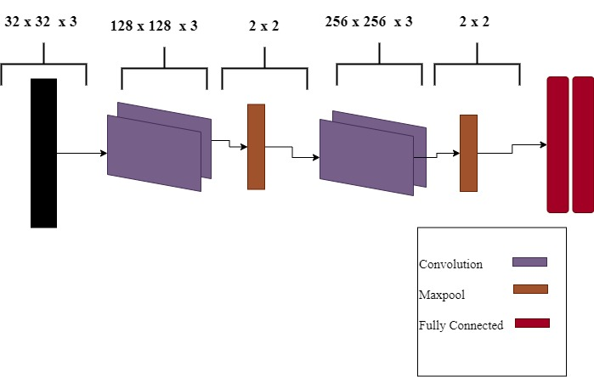
Visualizing Data Display sample images from the dataset

Slide 7
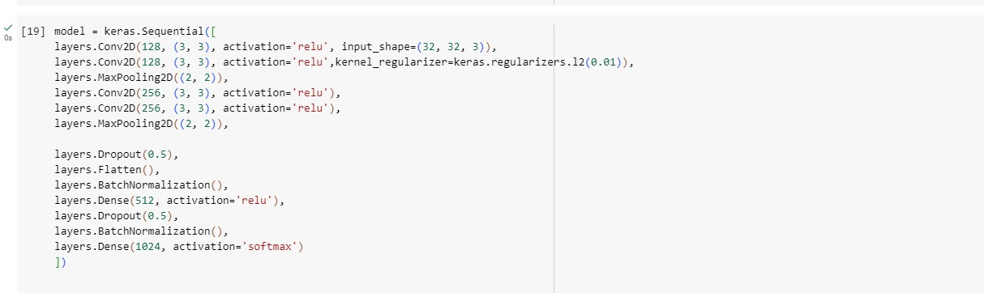
Building the CNN Model

Slide 8
CONTINUED
Explanation of Each Layer's Role in Feature Extraction:
Convolutional Layer:
Role: Responsible for detecting spatial patterns in the input image using filters (feature detectors).
Parameters: 32 filters, each with a 3x3 kernel, and 'relu' activation function.
Effect: Extracts low to high-level features by convolving the input with the learned filters.
MaxPooling Layer:
Role: Reduces spatial dimensions, focusing on the most important information.
Parameters: 2x2 pool size.
Effect: Down-samples the feature maps, retaining the most significant information and reducing computation.
Flatten Layer:
Role: Converts the 2D feature maps into a 1D vector.
Effect: Prepares the data for input to the fully connected layers.
Dense Layer (Hidden Layer):
Role: Processes the flattened features using densely connected neurons.
Parameters: 128 neurons with 'relu' activation.
Effect: Captures complex patterns and relationships in the feature space.

Slide 9
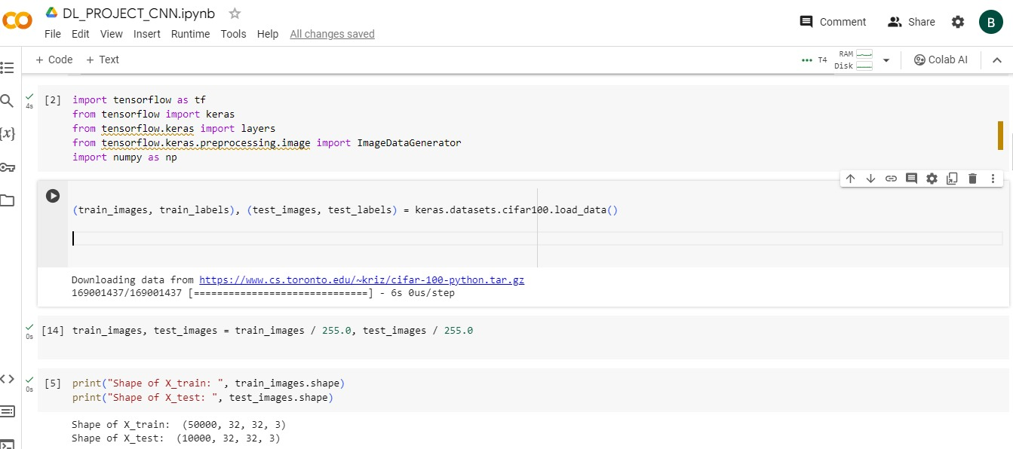
Training the Model
Train the model on the CIFAR-100 dataset

Slide 10
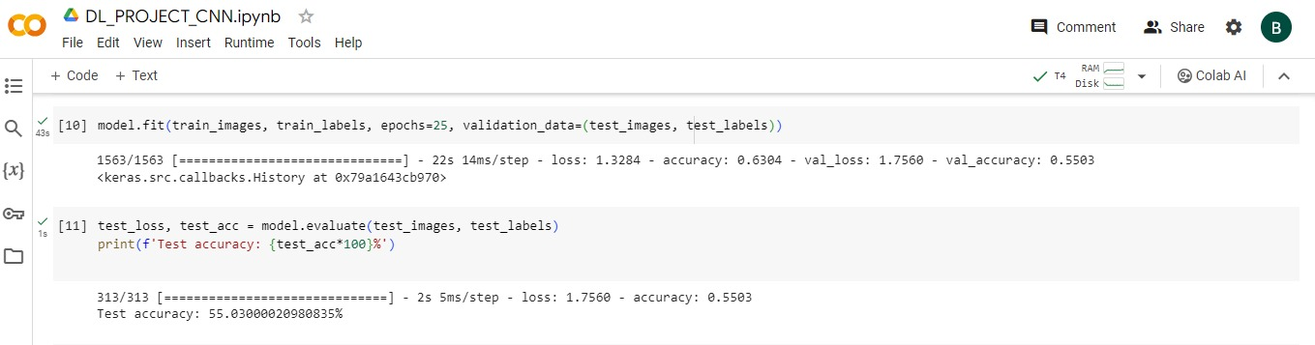
Results

